Slide 1
sql server

Slide 2
Wildcard Characters
% (Percent): Represents zero or more characters.
_ (Underscore): Represents a single character.
[] (Square Brackets): Represents any single character within the brackets (like a set of characters)
[^] (Caret inside square brackets): Represents any single character not within the brackets.

Slide 3
SELECT * FROM STUDENT WHERE Name LIKE 'A%';
-- Finds any name starting with 'A'
SELECT * FROM STUDENT WHERE Name LIKE '_an';
-- Finds names like 'Dan', 'Jan', etc.
SELECT * FROM STUDENT WHERE Name LIKE '[CD]an';
-- Finds names like 'Dan' or 'Can'
SELECT * FROM STUDENT WHERE Name LIKE '[^A]an';
-- Finds names that do not start with 'A', like 'Dan', 'Can', etc.

Slide 4
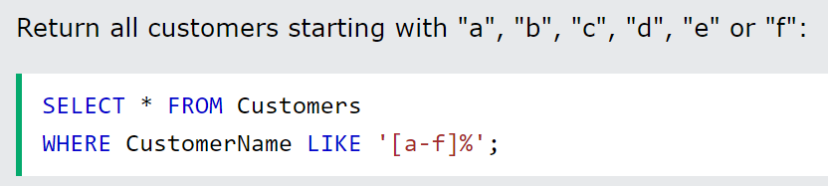
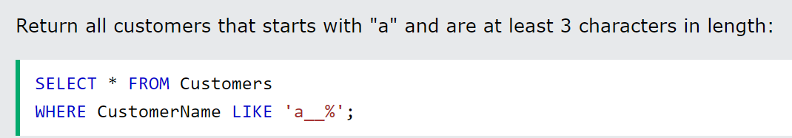
EX:

Slide 5
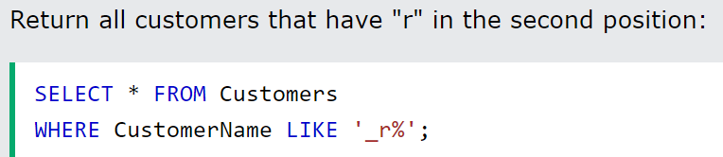
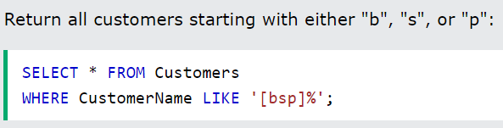

Slide 6
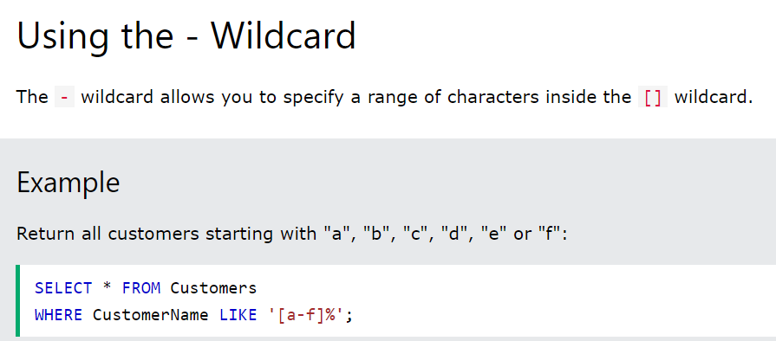

Slide 7
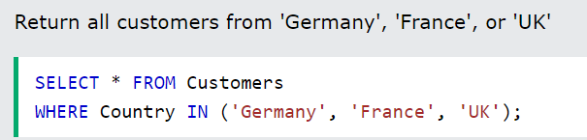
IN
SELECT column_name(s)
FROM table_name
WHERE column_name IN (value1, value2, ...);

Slide 8
SELECT column_name(s)
FROM table_name
WHERE column_name IN (value1, value2, ...);

Slide 9
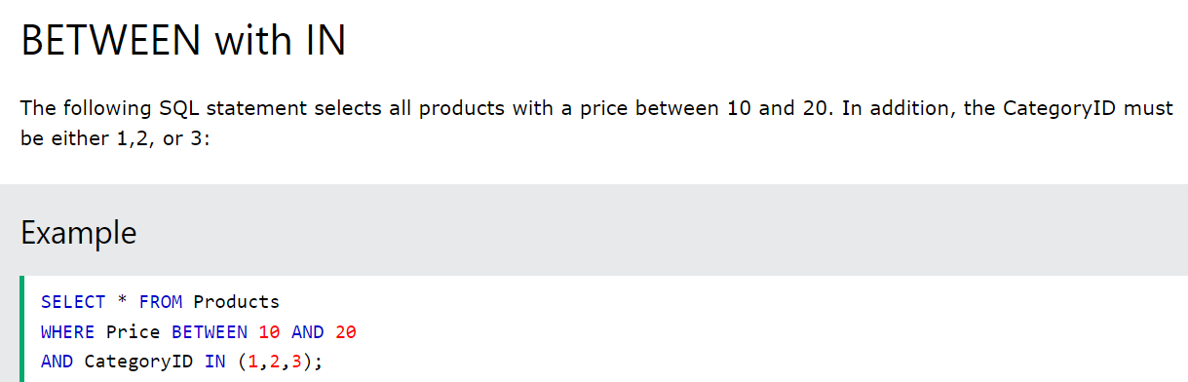
BETWEEN ... AND

Slide 10
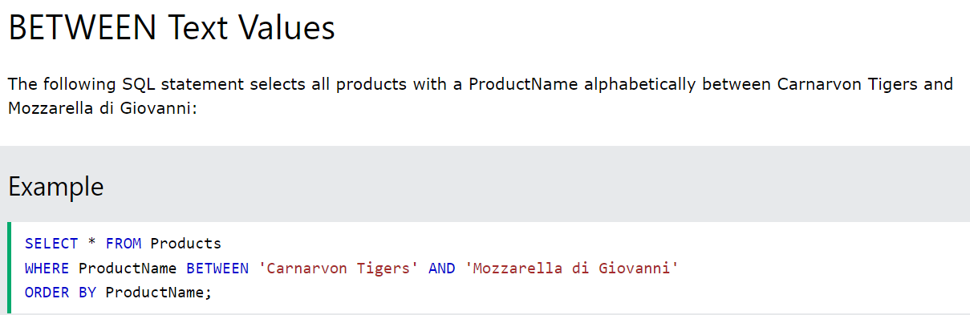

Slide 11
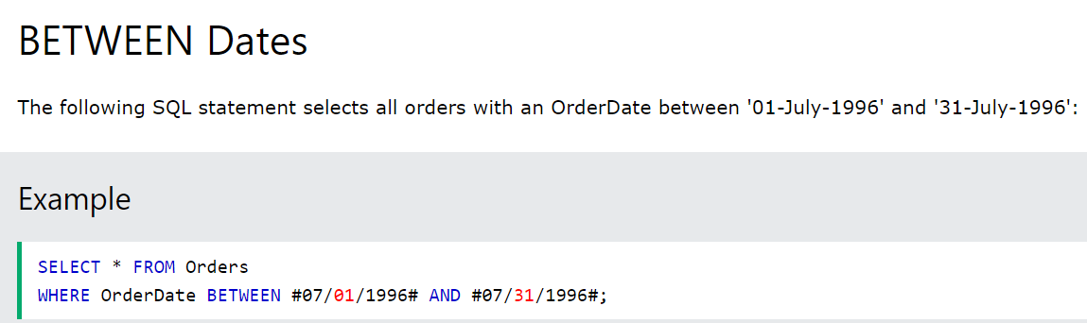
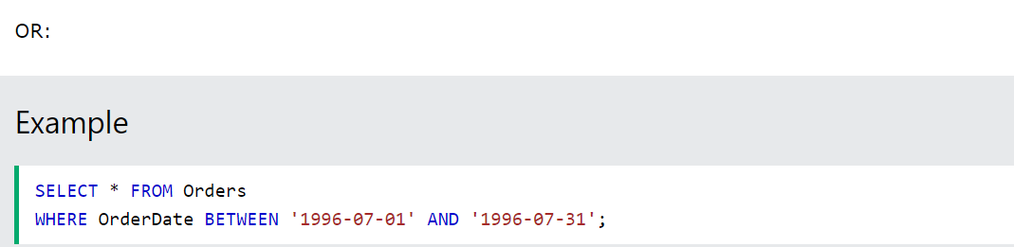

Slide 12
GROUP BY
SELECT column_name(s)
FROM table_name
WHERE condition
GROUP BY column_name(s)
ORDER BY column_name(s);

Slide 13
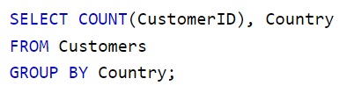
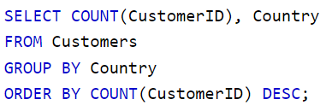

Slide 14
HAVING
SELECT column_name(s)
FROM table_name
WHERE condition
GROUP BY column_name(s)
HAVING condition
ORDER BY column_name(s);

Slide 15
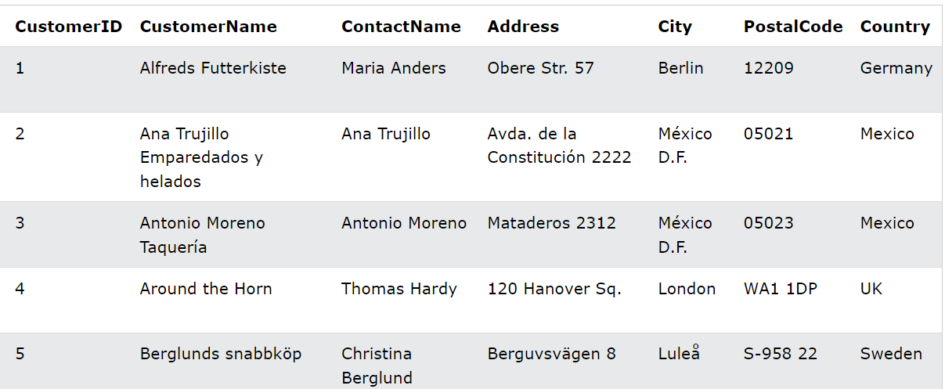

Slide 16
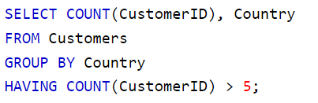
The following SQL statement lists the number of customers in each country. Only include countries with more than 5 customers:

Slide 17
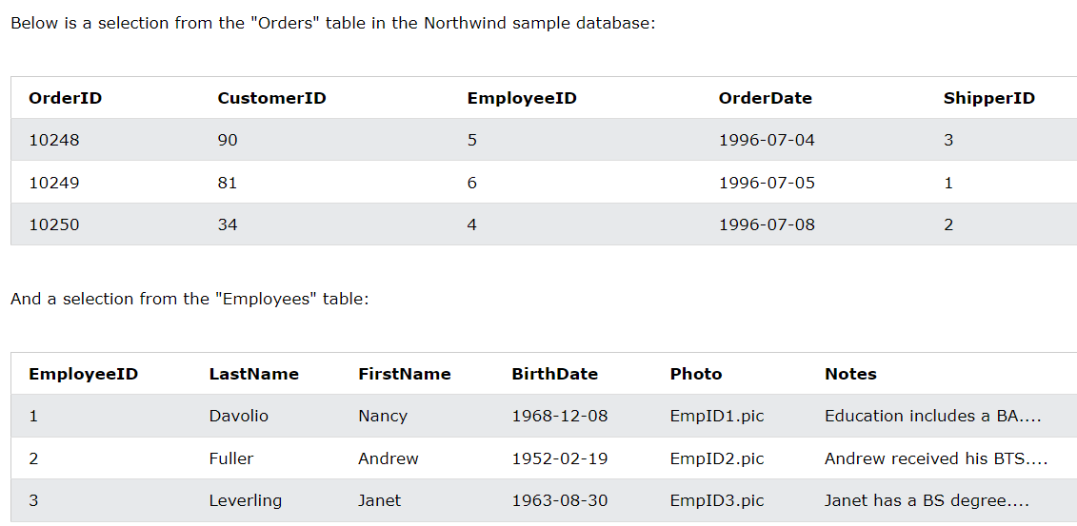

Slide 18
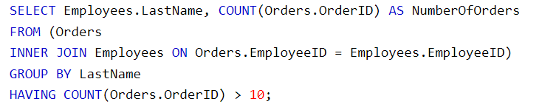
The following SQL statement lists the employees that have registered more than 10 orders:

Slide 19
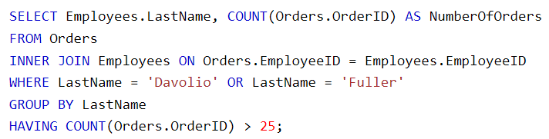
Lists if the employees "Davolio" or "Fuller" have registered more than 25 orders:

Slide 20
EXISTS
SELECT column_name(s)
FROM table_name
WHERE EXISTS
(
SELECT column_name
FROM table_name
WHERE condition
);

Slide 21
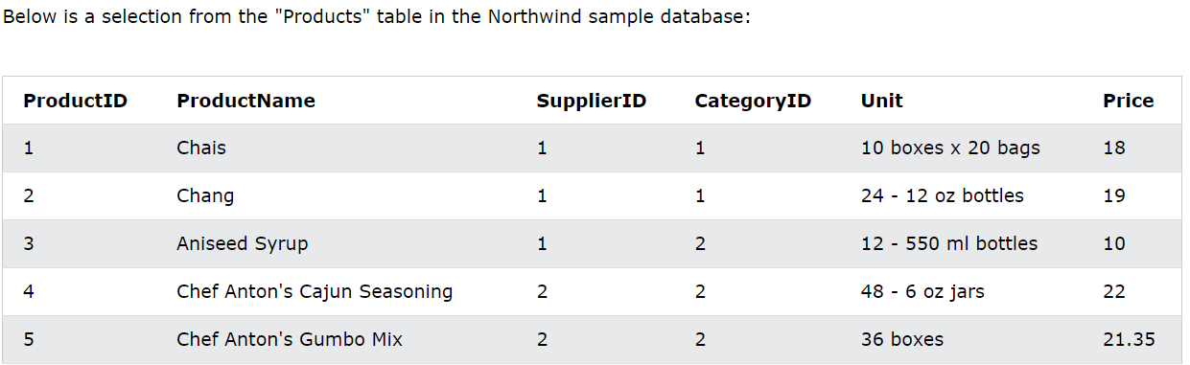
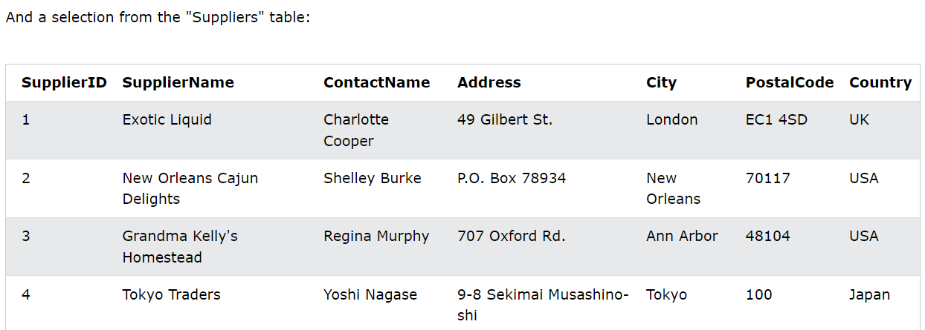

Slide 22
The following SQL statement returns TRUE and lists the suppliers with a product price less than 20:
SELECT SupplierName
FROM Suppliers a
WHERE EXISTS
( SELECT ProductName
FROM Products b
WHERE b.SupplierID = A.supplierID AND Price < 20
);

Slide 23
ANY/ ALL
SELECT column_name(s)
FROM table_name
WHERE column_name operator ANY
(SELECT column_name
FROM table_name
WHERE condition);
Note:
The operator must be (=, <>, !=, >, >=, <, or <=).

Slide 24
ALL Syntax With WHERE or HAVING
SELECT column_name(s)
FROM table_name
WHERE column_name operator ALL
(SELECT column_name
FROM table_name
WHERE condition);

Slide 25
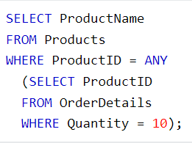

Slide 26
CASE
CASE
WHEN condition1 THEN result1
WHEN condition2 THEN result2
WHEN conditionN THEN resultN
ELSE result
END;

Slide 27
SELECT OrderID, Quantity,
CASE
WHEN Quantity > 30 THEN 'The quantity is greater than 30'
WHEN Quantity = 30 THEN 'The quantity is 30'
ELSE 'The quantity is under 30'
END AS QuantityText
FROM OrderDetails;

Slide 28
SELECT CustomerName, City, Country
FROM Customers
ORDER BY
(CASE
WHEN City IS NULL THEN Country
ELSE City
END);

